Slide 1
TASK 3
REPORT

Slide 2
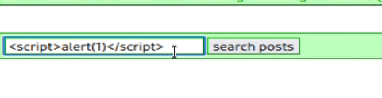
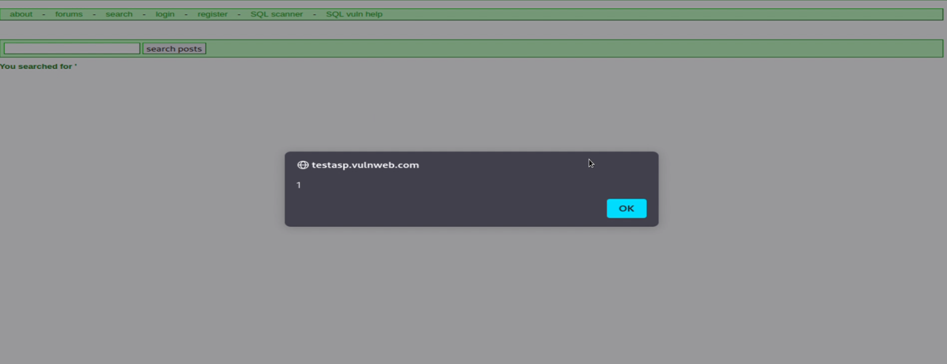

Slide 3
Title: Cross Site Scripting Domain: vulnweb.com Subdomain: testasp.vulnweb.com
vulnweb website http://testasp.vulnweb.com/ has an endpoint that is vulnerable to an injection vulnerability also known as Reflected Cross-Site Scripting (XSS). Cross-site scripting allows attackers to enter into and inject malicious data using Javascript and other means.
This happens because one of the GET parameters "p" does not properly sanitize/escape user input, allowing an injection to occur.

Slide 4
Steps To Reproduce:
1) Visit website http://testasp.vulnweb.com/
2) Click on the search option which can be found on the top menu.
3) As soon as we click on the search button we can see a search box for entering inputs.
4) We can intercept the request on the Burpsuite.
5) Also we have to search the payloads related to XSS in the browser.
6) We have the send the request to the intruder and paste all the payloads in the payloads section.
7) Now start the attack by clicking on start attack button.
8) Find the vulnerabilities by observing the length and status each payload.
9) Wait till all the payloads execute.
10) Make a report of all the vulnerabilities.

Slide 5
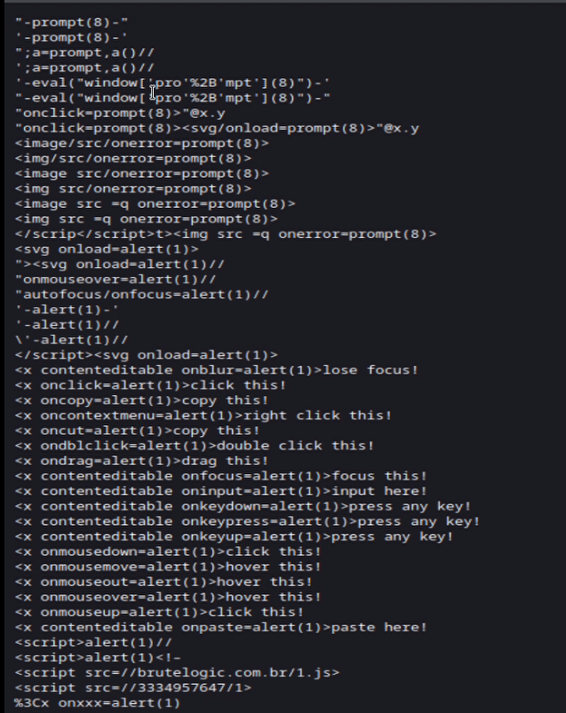
Payloads

Slide 6
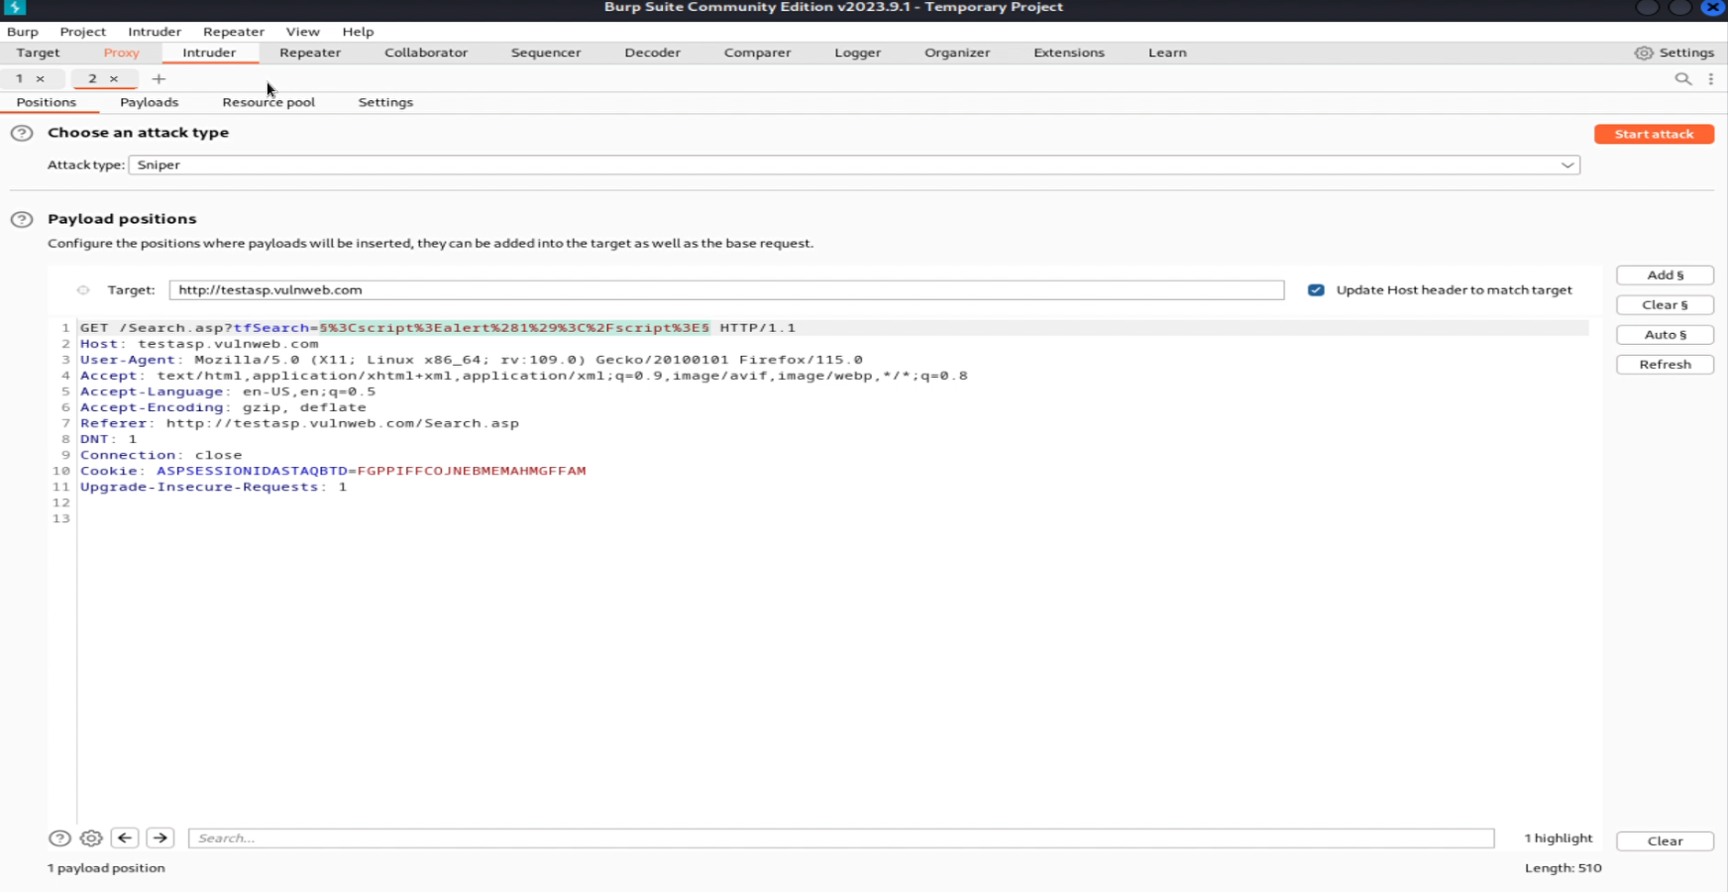

Slide 7
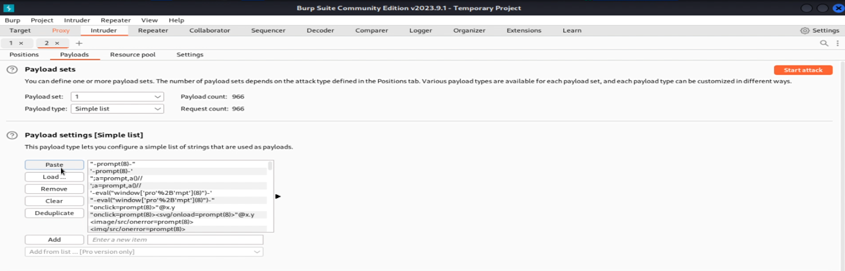

Slide 8
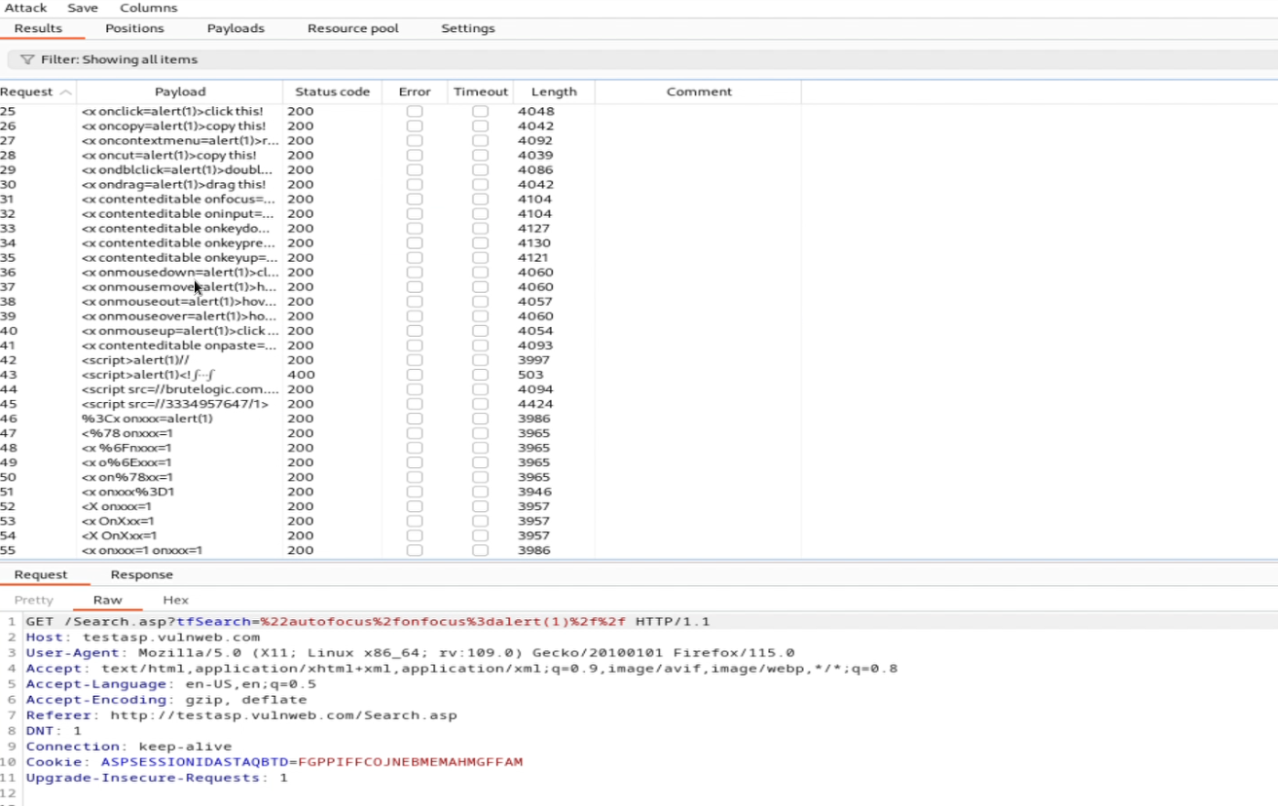

Slide 9
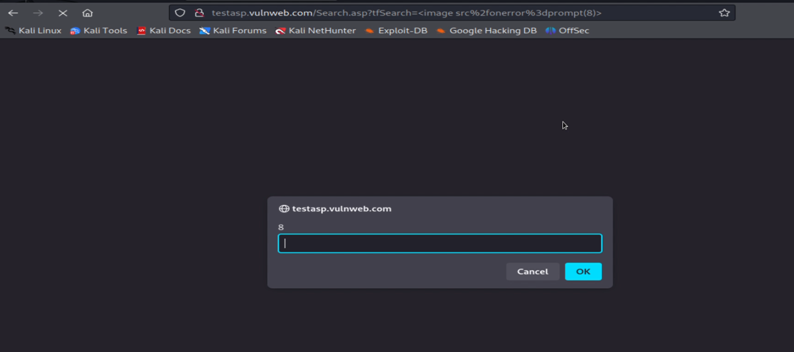

Slide 10
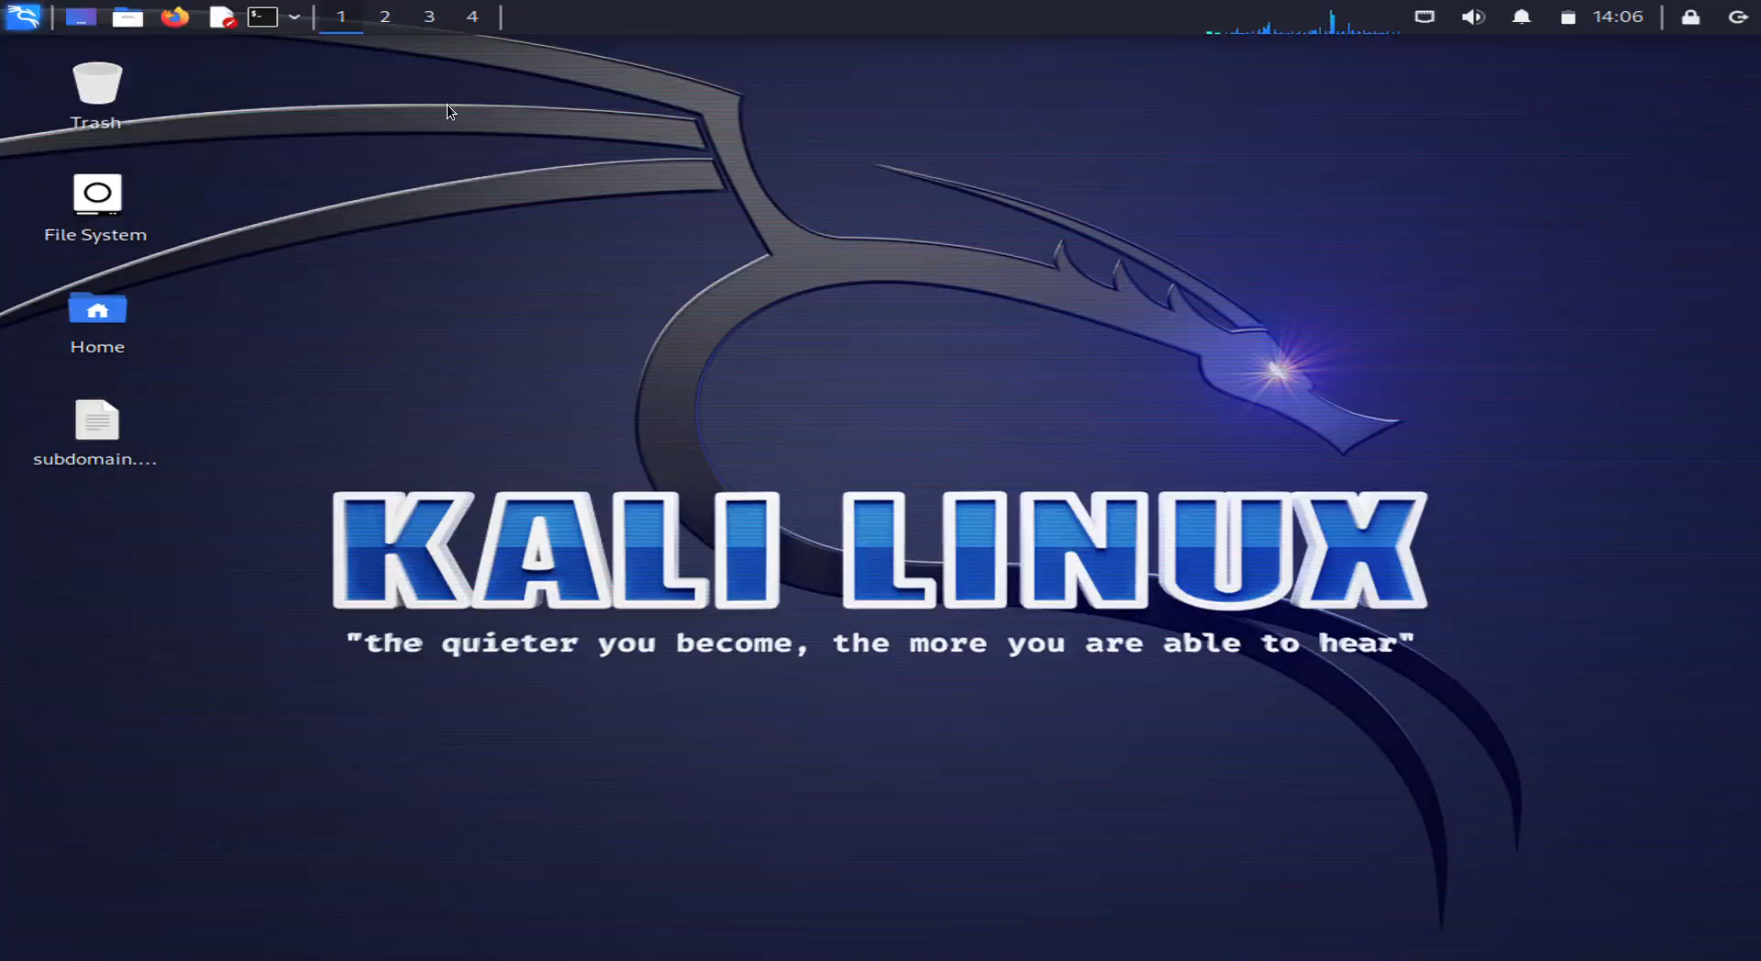
Video Demonstration

Slide 11
Impact:
Using Cross-site scripting one can manipulate the website’s code and steal important credentials like usernames and passwords. This can be a huge loss to the company's economy and reputation.
Mitigation:
To avoid Cross-site scripting it is recommended to enable the NoScript feature.

Slide 12
THANK YOU

